Slide 1
Work-case 7
Performed by student
group RPZ-13a
Kateryna Hranat

Slide 2
Task Scheduling in Operating Systems

Slide 3

1. Basic Functions of Task Scheduler:
- Allocation of Resources: Assigning resources like CPU time, memory, and I/O devices to tasks.
- Prioritization: Managing the order in which tasks are executed based on priorities.
- Synchronization: Coordinating tasks to avoid conflicts and ensure data integrity.
- Deadlock Handling: Resolving situations where tasks are waiting for resources held by each other, leading to a standstill.
- Fairness: Ensuring fair access to resources among competing tasks.
- Efficiency: Optimizing resource utilization to improve system performance.

Slide 4
2. Comparison between Windows and Linux:
Windows:
- Windows Task Scheduler provides a graphical interface for users to schedule tasks.
- It supports various triggers like time-based, event-based, and user logon.
- Users can prioritize tasks and set conditions for task execution.
- Tasks can be scheduled to run one-time, recurrently, or in response to specific events.
Linux:
- Linux primarily uses Cron (CronTab) for task scheduling, which is a command-line tool.
- Cron allows scheduling tasks with high precision using a cron expression, specifying minute, hour, day of the month, month, and day of the week.
- Tasks in Linux can be scheduled at a much finer granularity compared to Windows.
- Linux also supports atd (a task scheduling daemon) for one-time task scheduling.

Slide 5
Cron Scheduler in Linux

Slide 6

1. Principles of Cron:
- Configuration File: Cron jobs are defined in a configuration file called `crontab`.
- Syntax: Each line in `crontab` specifies a task and its schedule using a cron expression.
- Cron Expression: A cron expression consists of five fields: minute, hour, day of month, month, and day of week, followed by the command to execute.
- User-Specific: Each user can have their own `crontab`, allowing for personalized task scheduling.
- Logging: Output and errors from cron jobs are typically logged for monitoring and debugging.

Slide 7
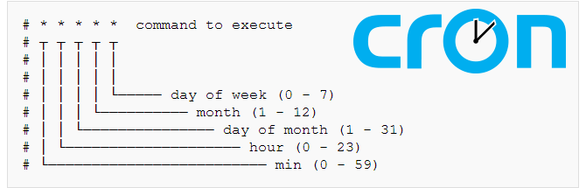
2. Configuration:
- To edit the crontab file, users can use the command `crontab -e`.
- Each line in the crontab file follows the format: `* * * * * command`, where each asterisk represents a time parameter (minute, hour, etc.).
- For example, `0 0 * * * /path/to/command` would execute the specified command every midnight.

Slide 8

3. Alternatives:
Systemd Timers: Systemd, the init system used in many Linux distributions, provides timer units that can be used as an alternative to cron.
Anacron: Anacron is useful for running periodic jobs on systems that might not be running 24/7, ensuring tasks are executed even if the system is powered off at the scheduled time.

Slide 9
Using Cron

Slide 10
Executing a Planned Task at a Specific Time: - Edit the crontab file using `crontab -e`.
- Add the following line to execute the task at 8:00 AM every day:
0 8 * * * /path/to/your/command
Executing the Same Task Twice a Day:
Add two lines to execute the task at the desired times, for example, at 9:00 AM and 6:30 PM:
0 9 * * * /path/to/your/command
30 18 * * * /path/to/your/command
Executing a Task Only on Weekdays (or Weekends) within a Specific Time Range:
To execute the task only on weekdays (Monday to Friday) from 8:00 AM to 6:00 PM:
* 8-18 * * 1-5 /path/to/your/command

Slide 11
Executing Tasks Once a Year, Once a Month, Once a Day, Every Hour, and on Boot:
To execute a task once a year (on January 1st at midnight):
0 0 1 1 * /path/to/your/command
To execute a task once a month (on the 1st day of each month at midnight):
0 0 1 * * /path/to/your/command
To execute a task once a day (every day at midnight):
0 0 * * * /path/to/your/command
To execute a task every hour:
0 * * * * /path/to/your/command
To execute a task on boot:
@reboot /path/to/your/command

Slide 12
Using an Alternative Task Scheduler

Slide 13
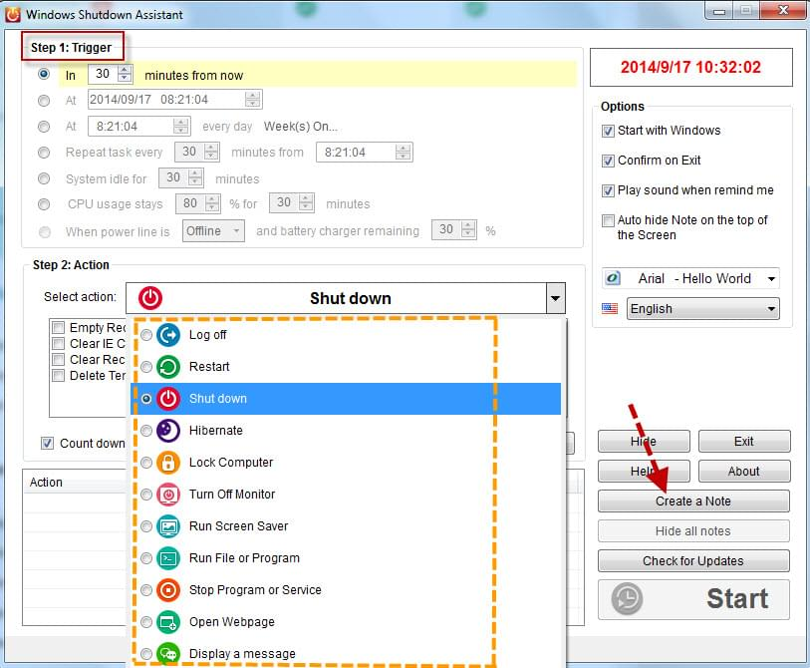
Using an Alternative Task Scheduler:
Installing and Using Systemd Timers:
- Create a new timer unit file in `/etc/systemd/system/` with a `.timer` extension, e.g., `my_task.timer`.
- Define the timer settings, such as `OnCalendar` for specific times or `OnBootSec` for boot events.
- Link the timer unit to a corresponding service unit that defines the action to execute.
- Enable and start the timer using `systemctl enable my_task.timer` and `systemctl start my_task.timer`.

Slide 14

Conclusions:
During the execution of the tasks outlined in the WorkCase, I gained a deeper understanding of task scheduling mechanisms in Linux operating systems. Through configuring Cron jobs, I better comprehended the nuances of time-based task execution, including precise scheduling, recurring tasks, and conditional execution based on weekdays or weekends. Furthermore, exploring alternative task schedulers like Systemd Timers broadened my knowledge of diverse scheduling approaches and enhanced my skills in system administration. Overall, this hands-on experience provided valuable insights into effectively managing and automating tasks in Linux environments, contributing to a more robust understanding of system orchestration and optimization.
Author – Kateryna Hranat

Slide 15
Thank you for attention!

